Slide 2
Beatitudes - Matthew 5:3-11
Makarios - Greek word which means blessed or happy is
All 8 sayings begin with the word ‘makarios’
Beatus - Latin word for blessed
Matthew 5:1-2 teaching to disciples
Matthew 7:28 teaching to the crowds
Matthew 6:8 do not be like the people around you

Slide 3
Beatitudes - Matthew 5:3-11
Makarios - Greek word which means blessed or happy is
All 8 sayings begin with the word ‘makarios’
Beatus - Latin word for blessed
Matthew 5:1-2 teaching to disciples
Matthew 7:28 teaching to the crowds
Matthew 6:8 do not be like the people around you

Slide 4
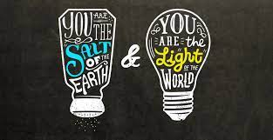
I

Slide 5
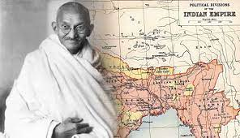
I
Ghandi “I don’t reject Christ. I love Christ. It’s just that so many of you Christians are so unlike Christ. If Christians would really live according to the teachings of Christ as found in the Bible, all of India would be Christian today.”

Slide 6
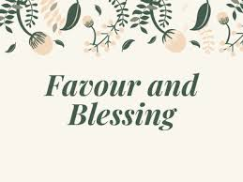
Blessed are the meek for they will inherit the earth Meaning of Blessed

Slide 7
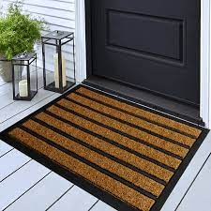
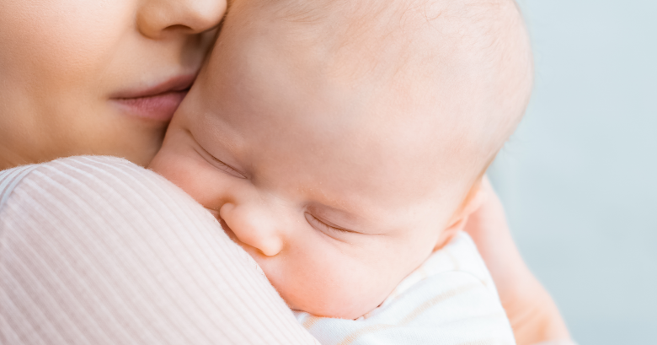
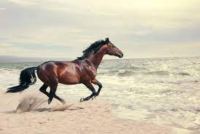
Blessed are the meek for they will inherit the earth Meaning of Meek

Slide 8
Evidence of Meekness
One’s attitude to oneself
Our relationship to God
Our care for others

Slide 9
Blessed are the meek for they will inherit the earth

Slide 10
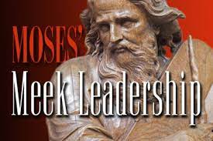
Examples of Meek

Slide 11
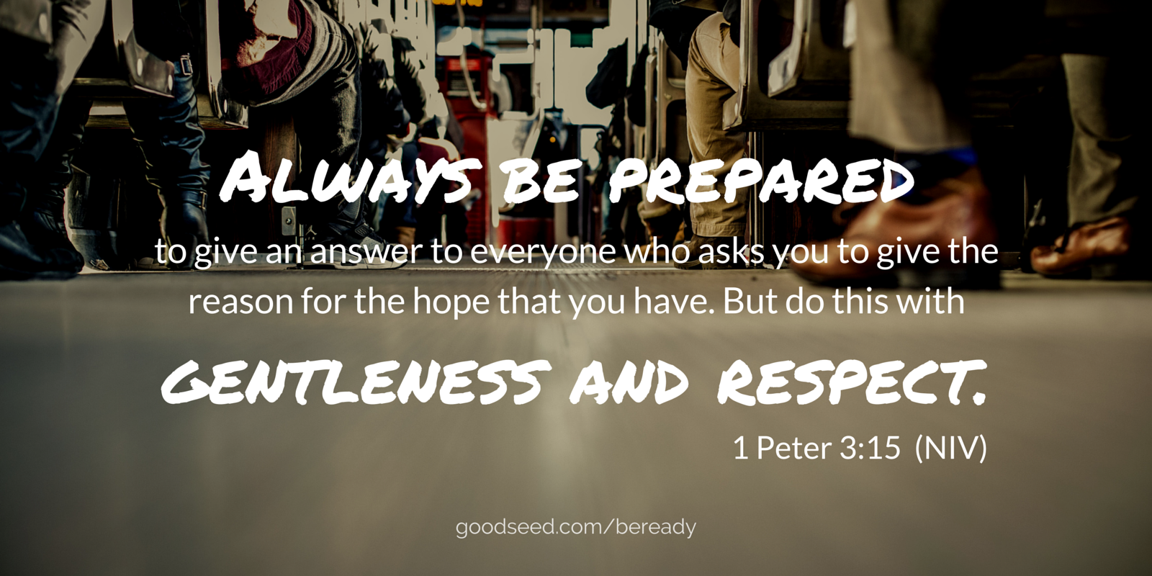
James 1:19-21 1 Peter 3:15

Slide 12
The be–attitudes precede the do-attitudes
Look at the evidence of meekness - are you known as being meek?
Check out your relationship with God – are there areas you need to trust God in?

